Slide 1
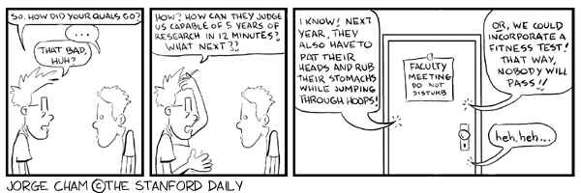
A guide to the qualifying exam UConn BME
Monty A. Escabí, Grad. Program Director

Slide 2
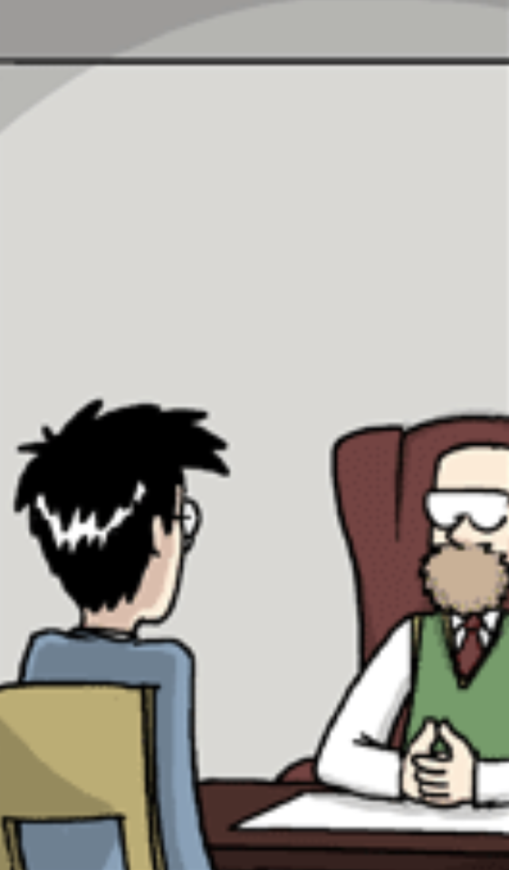
Why do I have to take a Qualifying Exam?
Yes …but there is more to it.
It’s a rite of passage.
Develop critical skills
Written and oral communication skills
Research project design and development
Critical thinking
Assessment
Your readiness for doing scholarly work and research
Basic knowledge in your track and research area
Your ability to think outside the box and think globally

Slide 3
Exam Format
Written Component
Formatted in the style of NIH style research project grant proposal (R01) .
Topics for each track are selected 2 month prior to the completion of the qualifying exams by a committee of faculty within each respective tract.
Oral Component
The student is required to defend the RO1 proposal as part of an oral examination.
Presentation should be <30 min
Total time including question session should be <2 hours.
Assessment and Outcomes
The advisory committee makes a pass/fail decision based on the combined results of the written component and oral presentation.
In the event of an unsuccessful attempt, the exam may be repeated once if necessary and at the discretion of the committee.

Slide 4
Exam Rubric
 | R1 | R2 | R3 | Avg.
A. Written proposal (grammar, clarity)
B. Hypothesis and Aims
C. Methodology proposed within the grant application
D. Oral Presentation (slides and student question and answer capability and composure under stress)
E. Comprehension and understanding of the literature and field of study
Items A-E are scored using a 1-5 rating system (1=poor; 2=fair; 3=average; 4=good; 5=excellent).
Individual reviewer scores (R1, R2 and R3) and average (Avg.) scores of the committee.
A passing grade is contingent on receiving an average 3.0 or above score on all items A

Slide 5
Exam Timeline
Key Dates: 5/9 6/20 7/15
(a) (b) (c)
a. Topics given to students + begin a 6-week writing period
Students to submit Abstract page @Week 1
Committees to screen for fairness and provide brief comments to student.
Aims must not overlap with PI’s current research Aims.
b. Proposals due + oral presentations begin
Student’s oral presentation =< 30 min; combined with Q&As, entire session <=2 hours.
PIs may watch student’s presentation, but cannot ask questions.
c. Committees makes final decision
Possible outcomes - pass, fail, or conditional pass
Resubmission may be due in 2 weeks
For fail, student will have another opportunity to take the exam

Slide 6
NIH Research Project Grants (R01)
8. Title
Limited to 81 characters
10. Project Summary (abstract)
<30 lines of text
Summary of proposed activity suitable for dissemination to public (e.g., media)
Provide information on significance (e.g., public health relevance)
11. Project Narrative
< 3 sentences.
Describe relevance to public health.
Should be succinct and use plain language suitable for a lay audience.
13. Specific Aims
1 page limit
State the goals and objectives of the proposed research.
Summarize the expected outcomes and including impact of research on fields involved.

Slide 7
NIH Research Project Grants (R01, continued)
14. Research Strategy
Limited to 12 pages
Bulk of the proposal
Significance
Describe the importance of the project within your field and the critical scientific/clinical questions it will address.
Describe how the project will contribute towards scientific knowledge, development of technologies and capabilities (research or clinical) in your field.
Describe how clinical and/or research concepts, methods, technologies, treatments and interventions will be enhanced in your field if the project aims are achieved.
B. Innovation
Explain how the project challenges scientific conventions and seeks
Describe advantages over existing methods.
Describe novel theoretical approaches and concepts that will arise from the research.
C. Approach
Describe the research strategy, methodology and analysis that will be carried out in order to accomplish the specific aims of the proposal.
Discuss potential problems, alternative strategies and benchmarks for successful completion of the project.

Slide 8
Resources
BME Quals page: https://www.bme.uconn.edu/doctoral-qualifying-exam/
Sample R01 Proposals: https://www.niaid.nih.gov/grants-contracts/sample-applications#r01
R01 Instructions (SF 424 Form): https://grants.nih.gov/grants/how-to-apply-application-guide/forms-g/general-forms-g.pdf
George Cham’s Piled Higher and Deeper (PHD) Comics - https://phdcomics.com

Slide 9
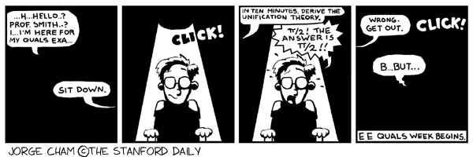
Thank You!

